Slide 1
Healthcare Dataset With Patient Demographics, Diagnoses, Treatments, And Hospital Charges.
K.SIRI REDDY
2211CS010311
S1-41

Slide 2

Introduction to Healthcare Datasets
Healthcare datasets encompass a wide range of patient information, including demographics, diagnoses, treatments, and hospital charges.
They are essential for analyzing healthcare quality, costs, and patient outcomes.
Proper management and analysis of these datasets can improve healthcare delivery and policy decisions.
Notes:
Image source: https://macgence.com

Slide 3
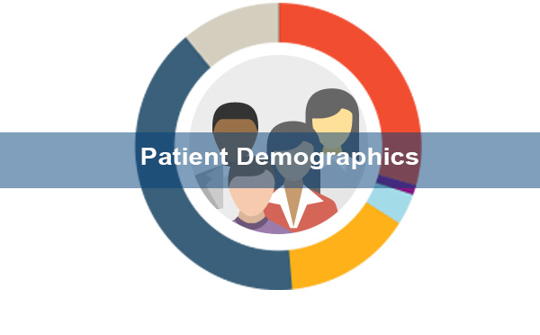
Patient Demographics Data
Demographics include age, gender, ethnicity, and socioeconomic status, which influence health outcomes.
Collecting accurate demographic data helps identify at-risk populations and tailor interventions.
Demographic information is vital for research, resource allocation, and personalized care planning.
Notes:
Image source: https://www.acnhealthcare.com

Slide 4
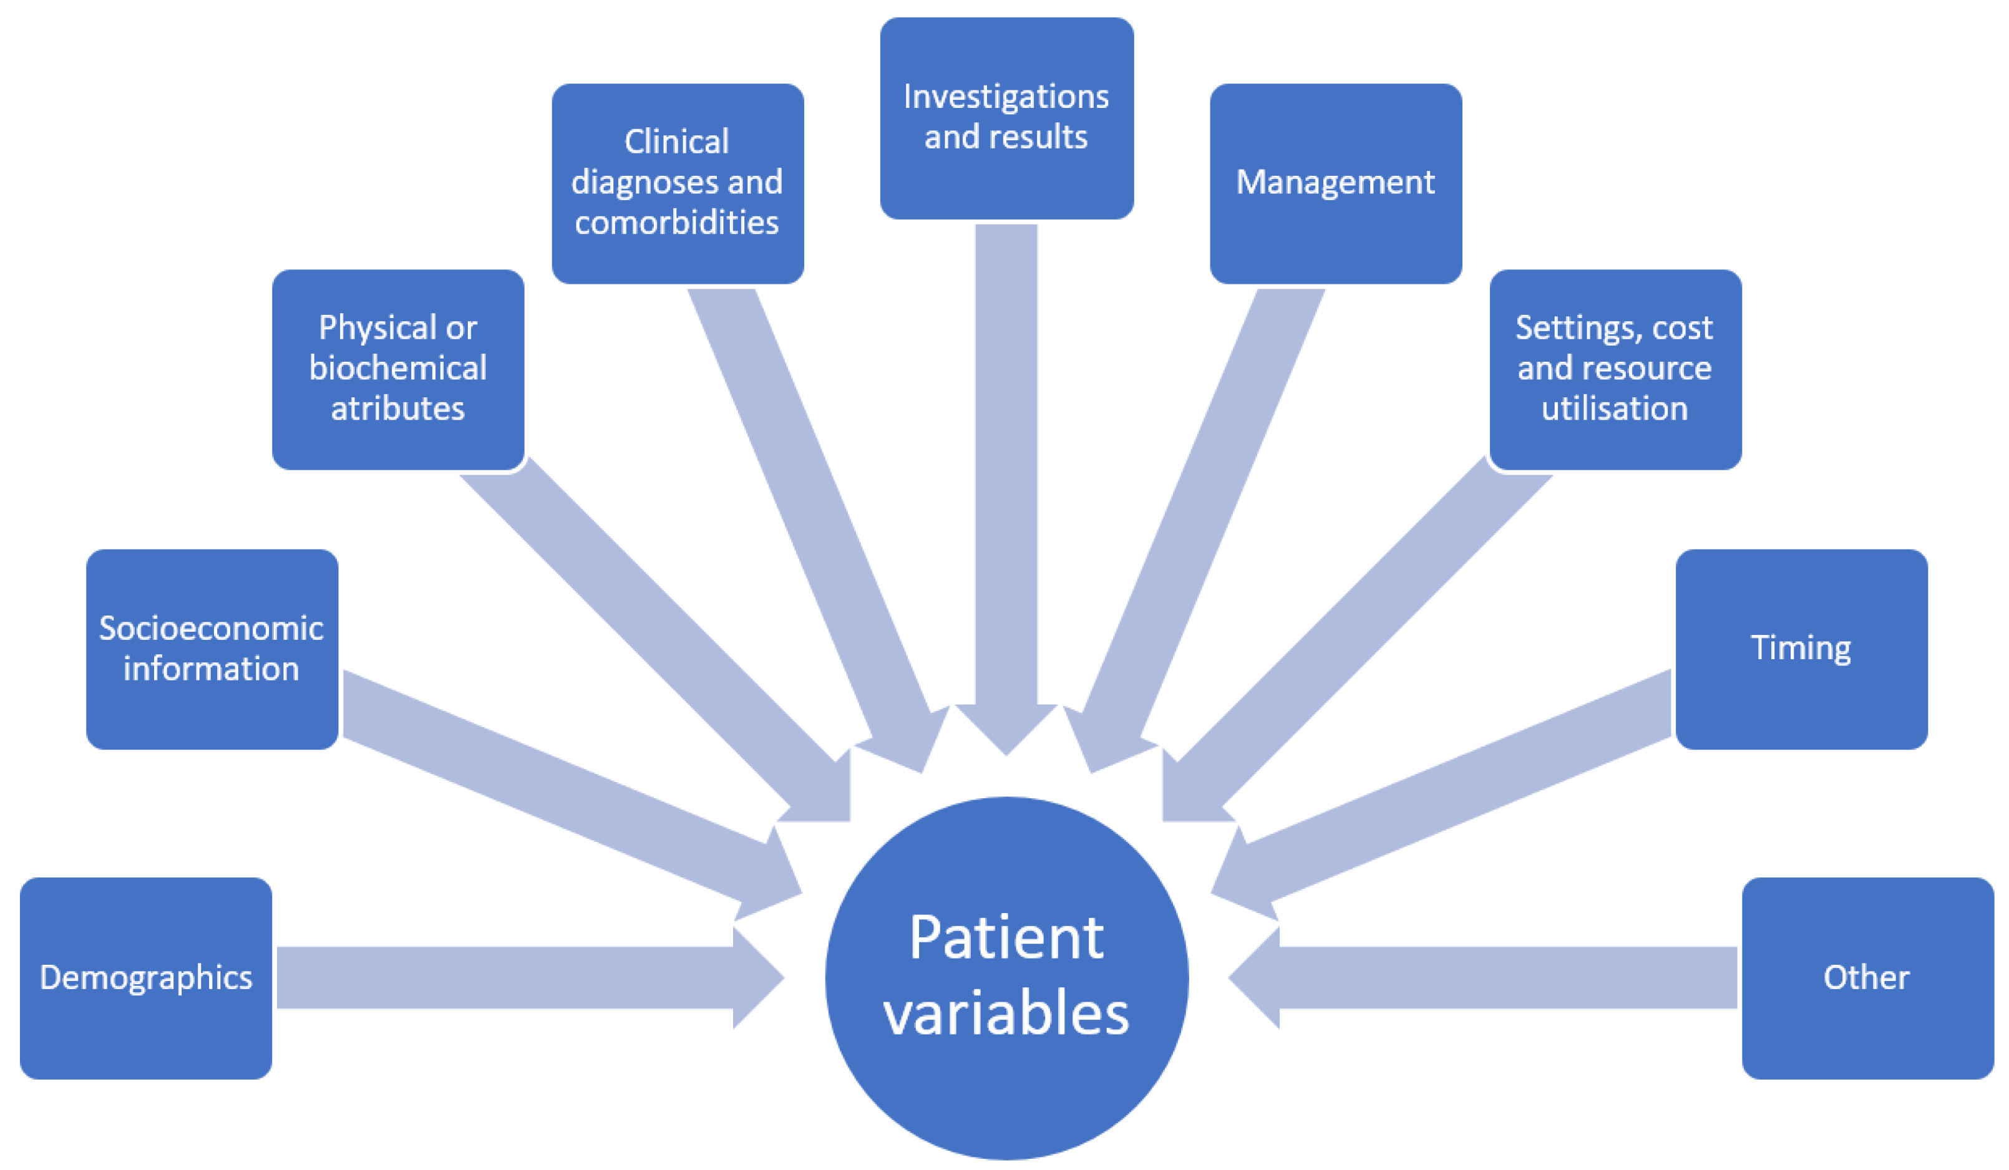
Diagnoses and Treatment Data
Diagnoses are recorded using standardized coding systems like ICD-10 to ensure consistency.
Treatment data includes procedures, medications, and therapy plans provided to patients.
Analyzing diagnosis and treatment data helps evaluate the effectiveness of interventions and clinical practices.
Notes:
Image source: https://pub.mdpi-res.com

Slide 5
Hospital Charges and Cost Analysis
Hospital charges encompass billing for services, procedures, and accommodations provided during care.
Analyzing charges helps identify cost drivers and areas for efficiency improvements.
Accurate charge data supports financial planning, reimbursement processes, and policy formulation.
Notes:
Image source: https://www.slidemake.com

Slide 6

Importance and Applications of Healthcare Data
Healthcare datasets enable research that improves patient care, reduces costs, and informs policy.
They support predictive analytics for early intervention and disease management.
Ensuring data privacy and security is crucial to maintain patient trust and comply with legal regulations.
Notes:
Image source: https://prognocis.com

